Slide 1

Bei 100 Mrd. Clicksteam-Events & Backend-Daten den Überblick wahren? Mit SQL geht’s - Eine Coding-Challenge
ITCS Hamburg 01. Juli 2022
Otto Group data.works
Josefine Kuka – Head of Data Engineering Hannes Ortmeier – Data Engineer
Otto Group data.works GmbH

Slide 2
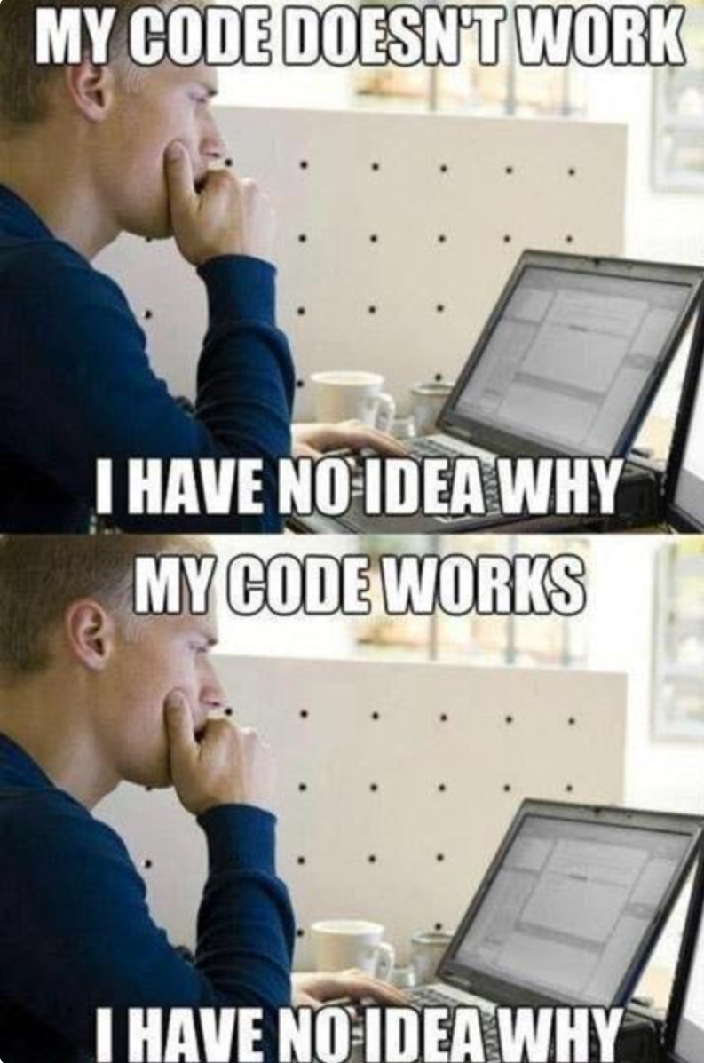
Agenda
Introduction of data.works, Josefine and Hannes (20 min)
Introduction to the coding challenges (10 min)
Coding challenges (35 min)
Discussion of your solutions and execution against out data pool (20 min)
Wrap up (5 min)

Slide 3




Otto Group data.works GmbH at a Glance
>40
~20
>300
>25
Colleagues with different backgrounds and expertise
Group companies are our customers
Terrabytes of data stored in our datapool
Digital products and currently running apps

Slide 4
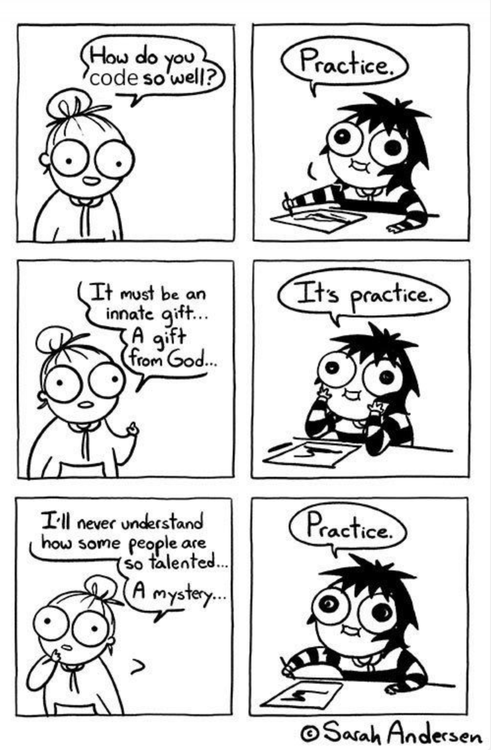
Coding-Challenge Workshop
Code SQL statements to handle product and user data
Three real life challenges to choose from
Ordered by difficulty from easy to hard
Execute your solution against the biggest e-commerce data pool in DACH region
Bonus questions:
How much GB of data does your query move?
How expensive will your query be?
How long will the execution of your query take?

Slide 5
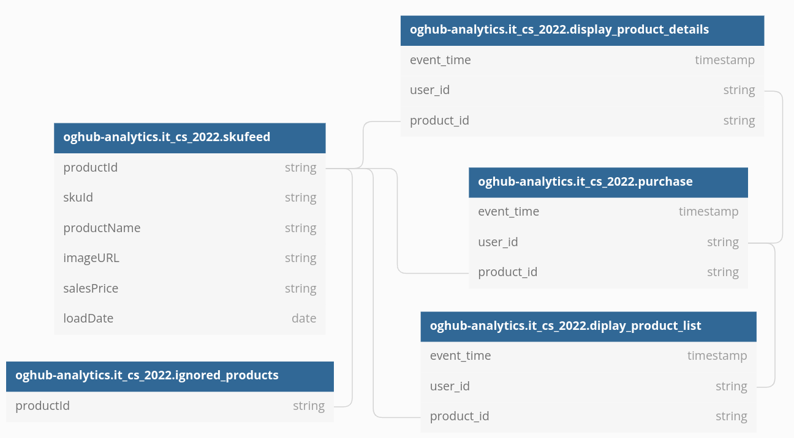
Coding-Challenge Data Tables

Slide 6
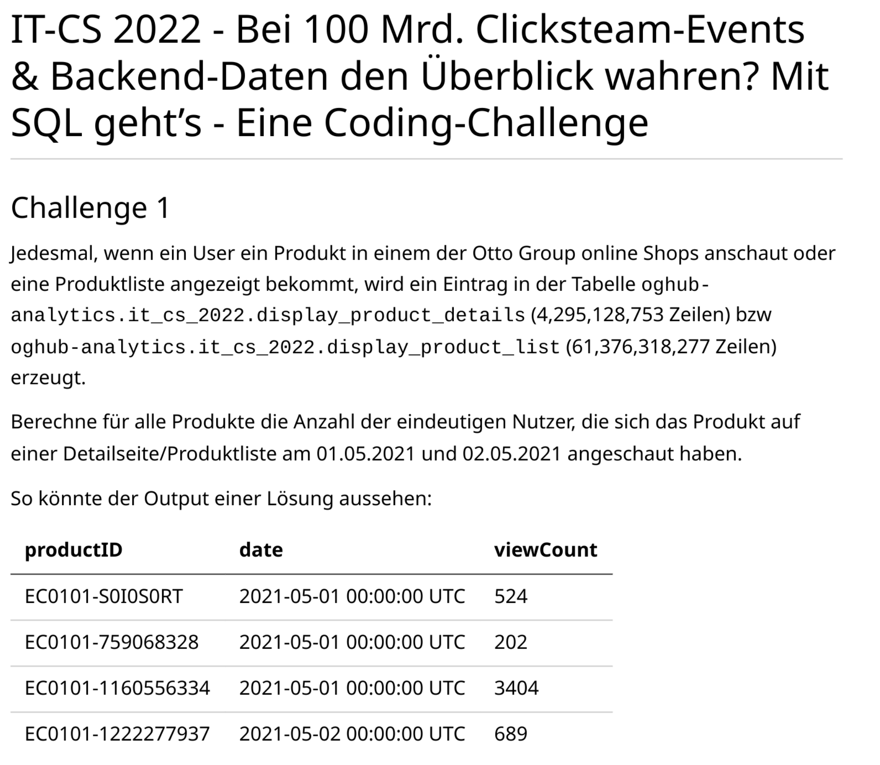
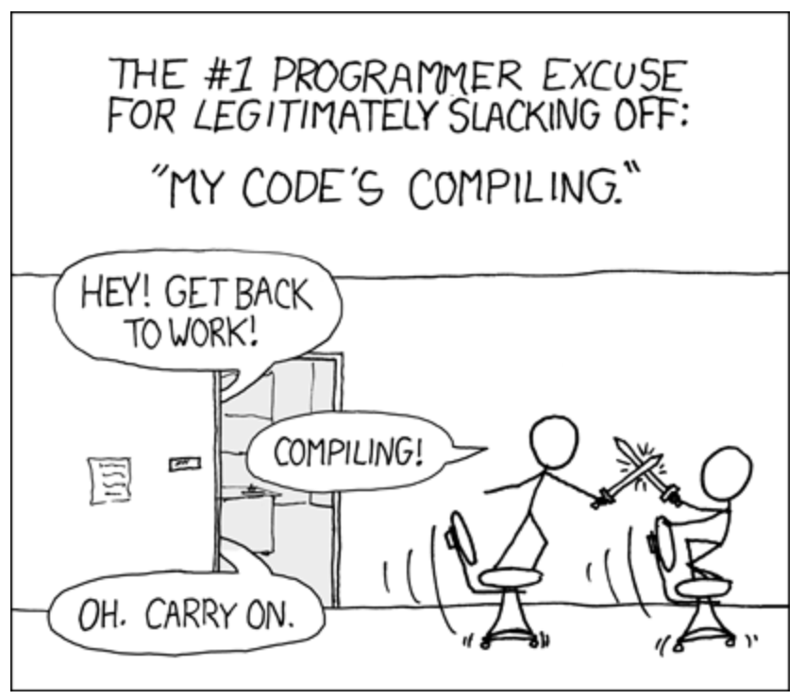
Coding-Challenge Workshop – Challenge 1

Slide 7
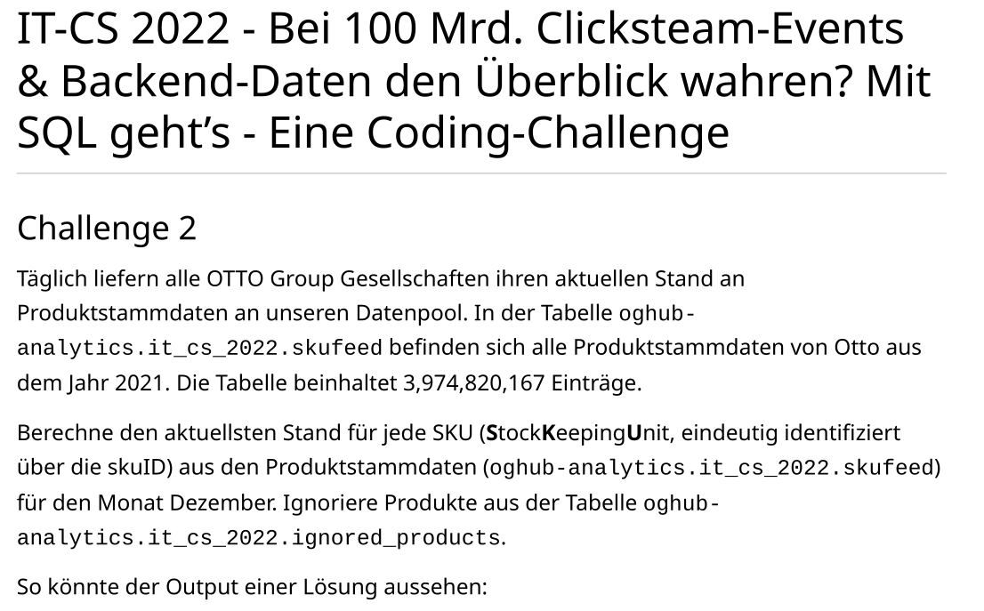
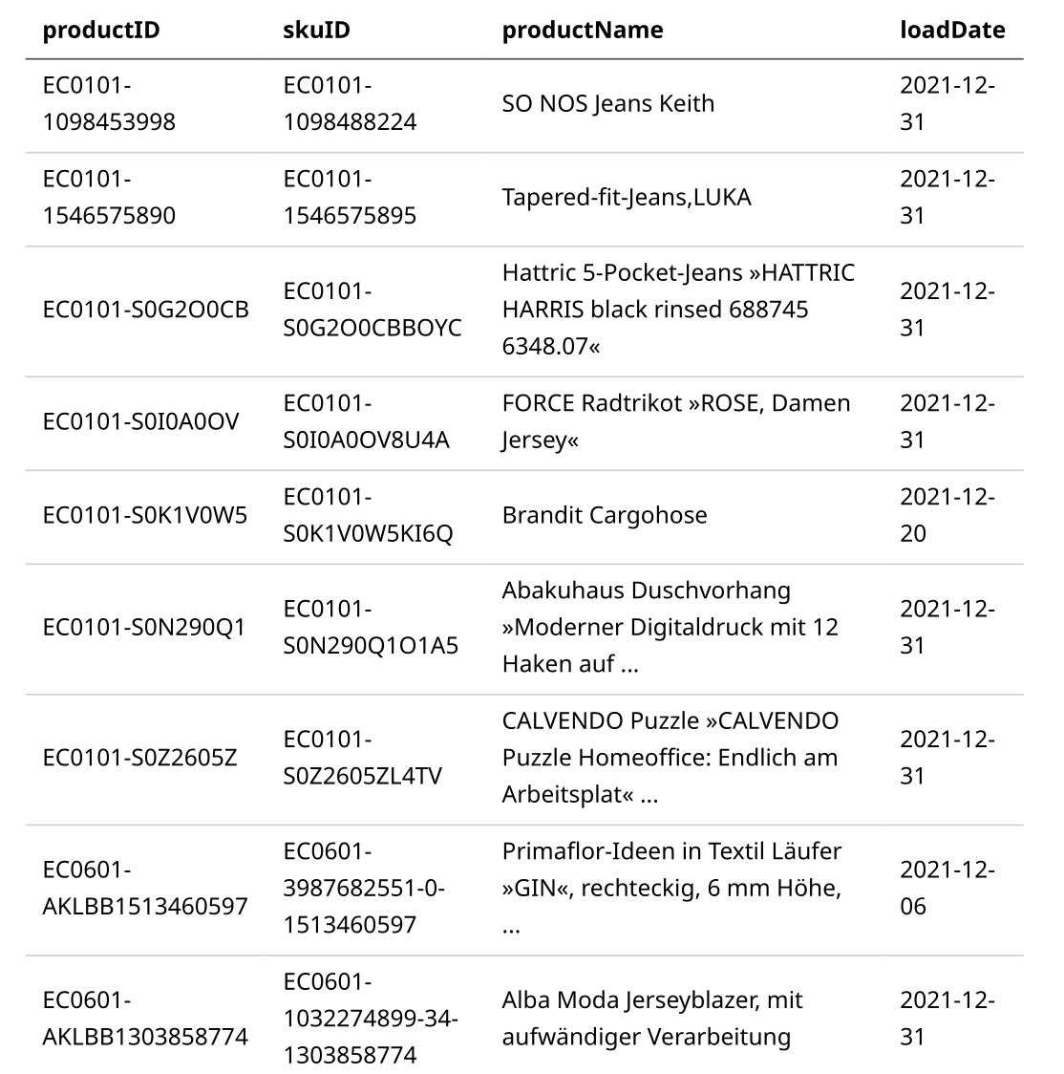
Coding-Challenge Workshop – Challenge 2

Slide 8
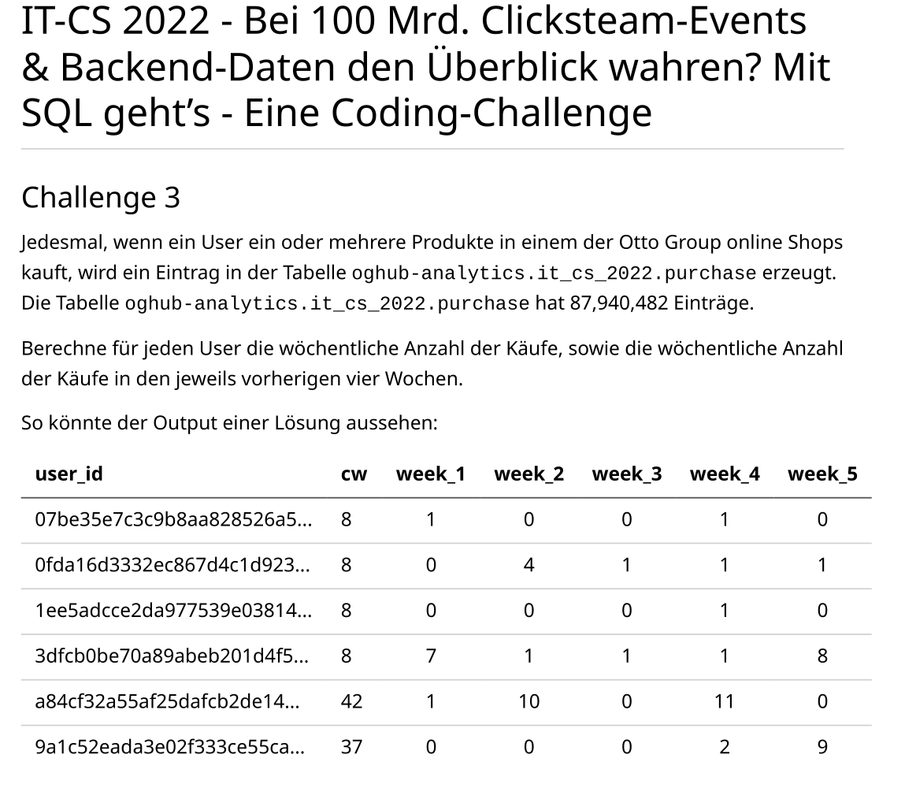
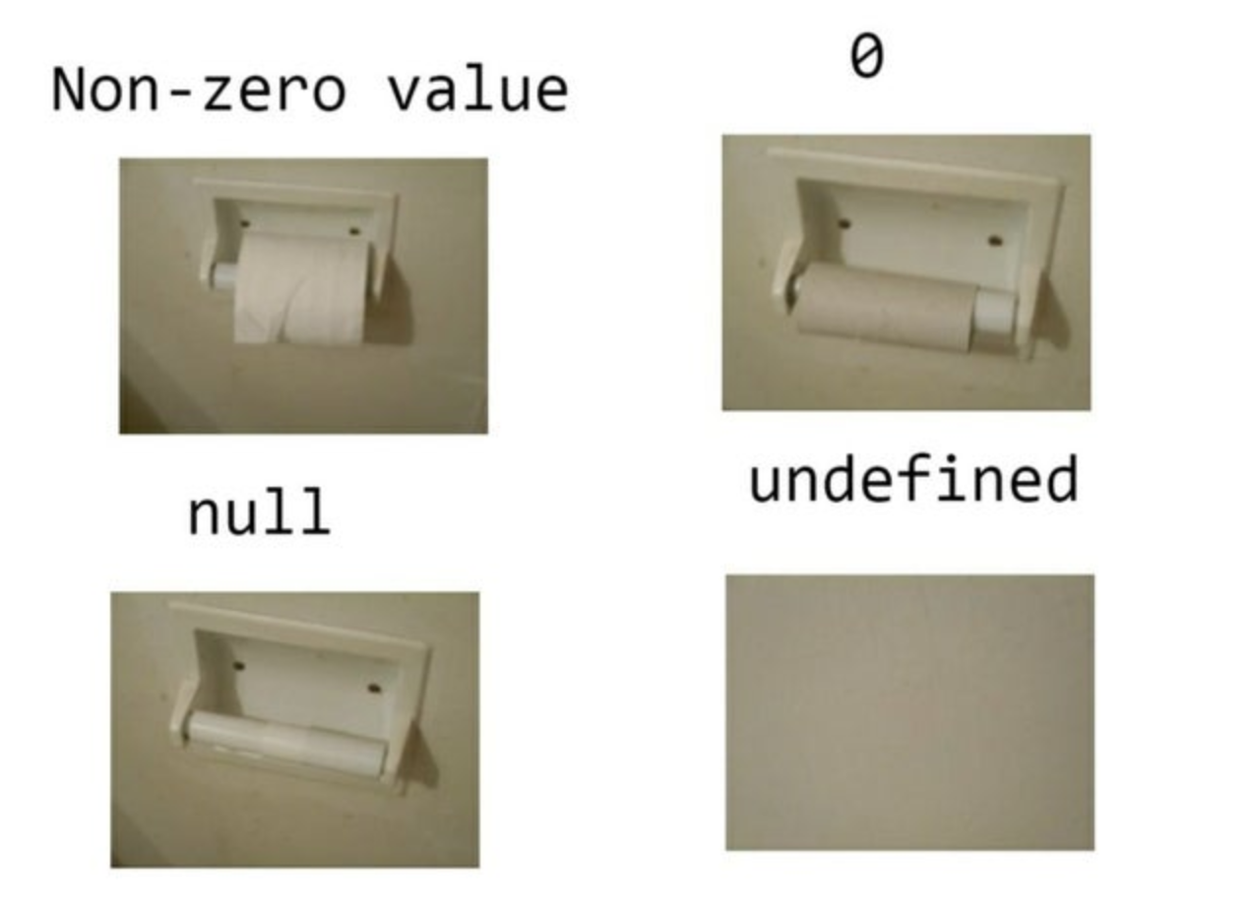
Coding-Challenge Workshop – Challenge 3

Slide 9
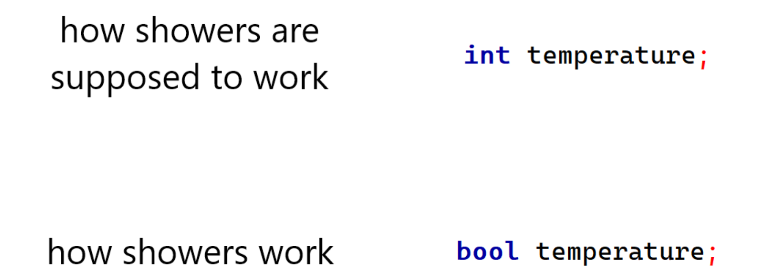
Coding-Challenge Workshop
You can find the full challenges and db diagramm under https://github.com/hannesortmeier/og_it_cs_2022
If you want your solution to be executed against our BigQuery data pool, please send your solutions per email to hannes.ortmeier@ottogroup.com
I will upload solutions to the challenges to the github repository after the workshop

Slide 10
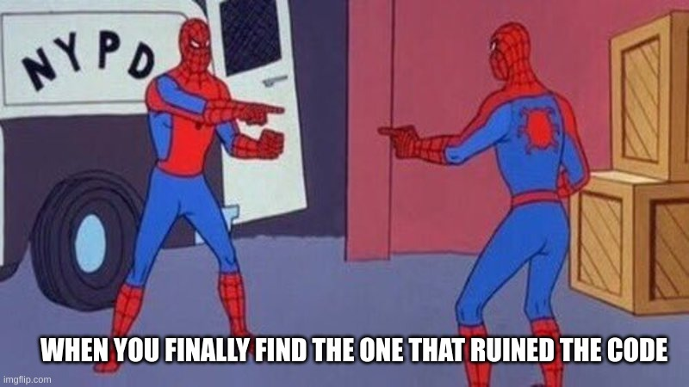
Wrap up
If working with Big Data interests you, please have a look at our job postings at otto.de/jobs
For further questions or feedback please feel free to contact me at hannes.ortmeier@ottogroup.com or https://linkedin.com/in/hannes-ortmeier

Slide 11
Thank you!

